Slide 1
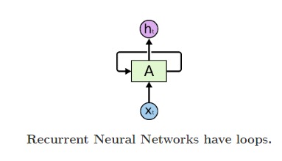
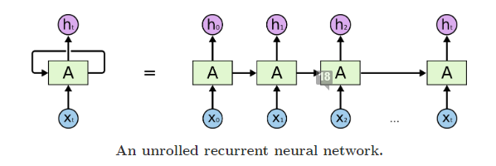
Recurrent Neural Network

Slide 2
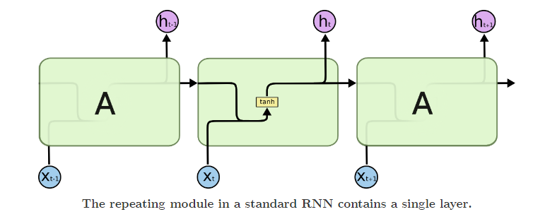
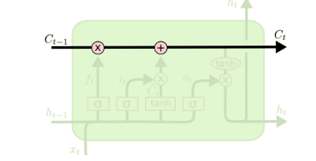
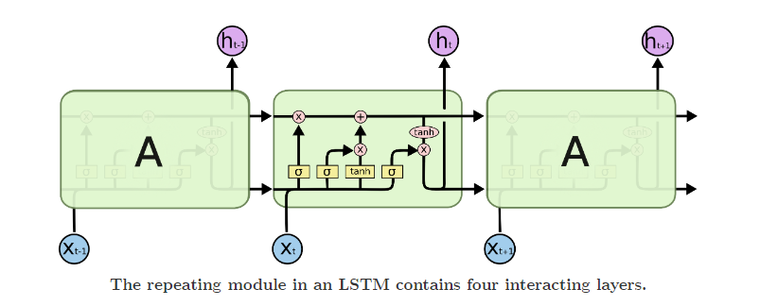
LSTM

Slide 3
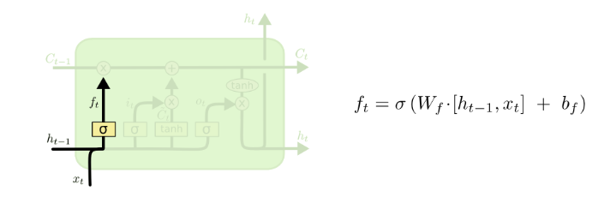
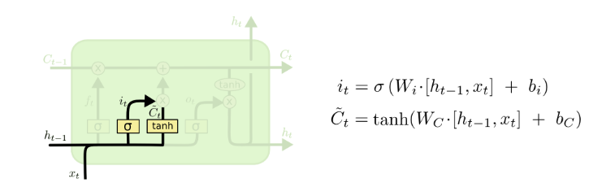
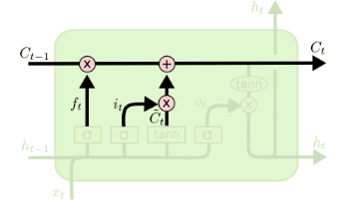

Slide 4
Generative Adversarial Networks (GANs)
From Ian Goodfellow et al.

Slide 5
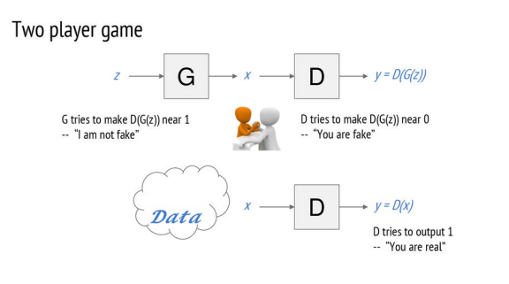

Slide 6
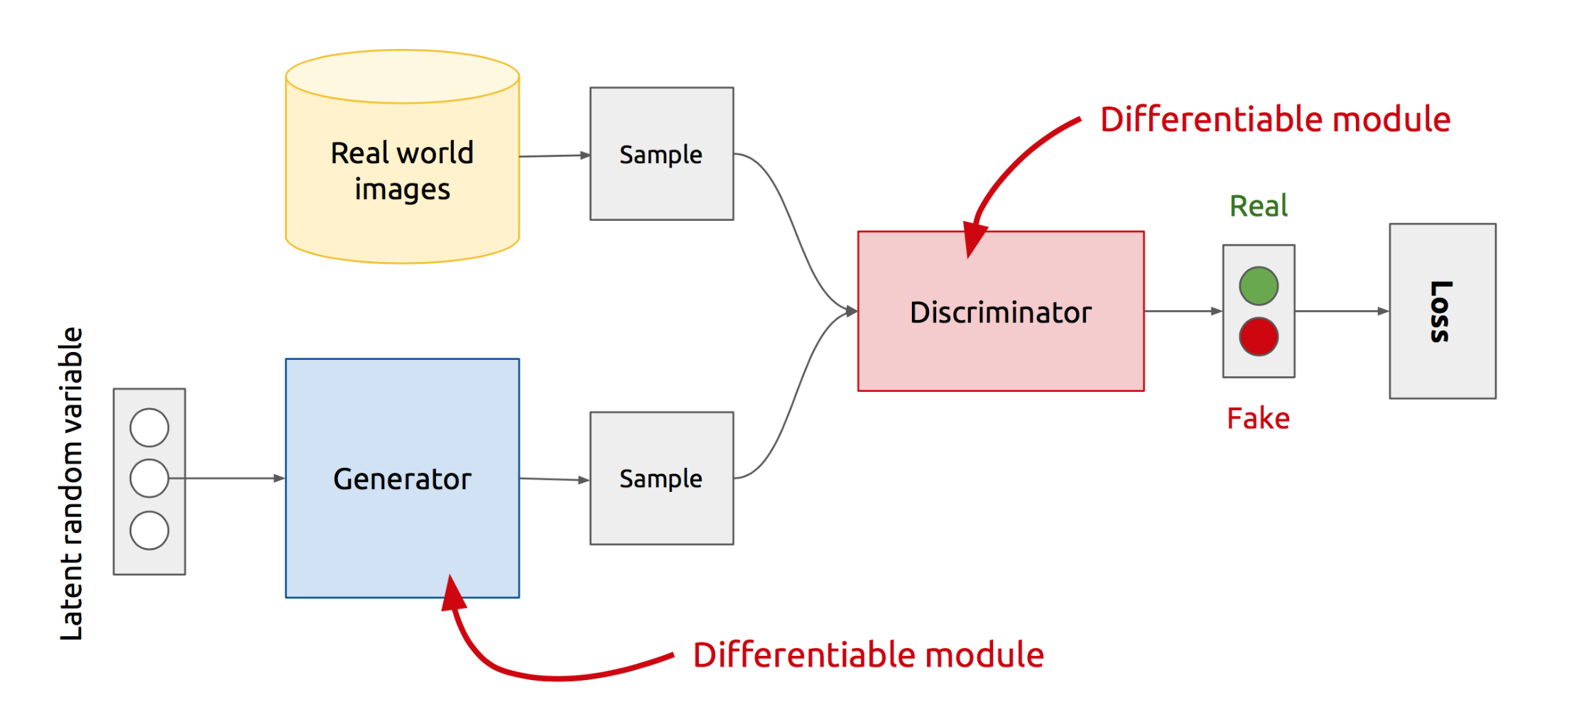
GAN’s Architecture
x
D
D(x)
G
z
G(z)
D(G(z))
Z is some random noise (Gaussian/Uniform).
Z can be thought as the latent representation of the image.
Notes:
Let’s look at the real GAN architecture now :-
-- We have two networks here Generator and Discriminator
-- Discriminator gets input from both the Generator and Real training samples and predicts which one is real and which one is fake.
-- The way Generator generates fake images is .. It randomly samples a noise z, passes it through its network, and the output of the network gives us the image.
-- So, the rationale with that will be that z is sort of your latent representation for the image.. And you generate the image from your latent representation by passing it through the generator network.
Never directly see true samples.

Slide 7
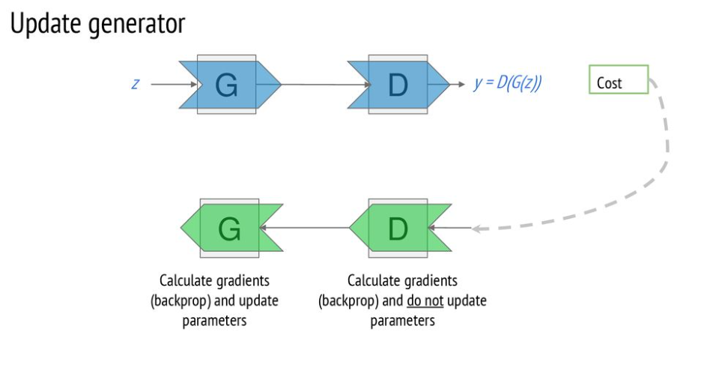
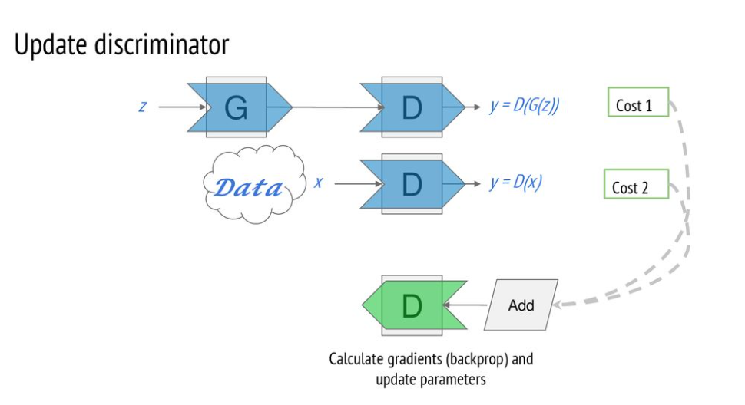

Slide 8
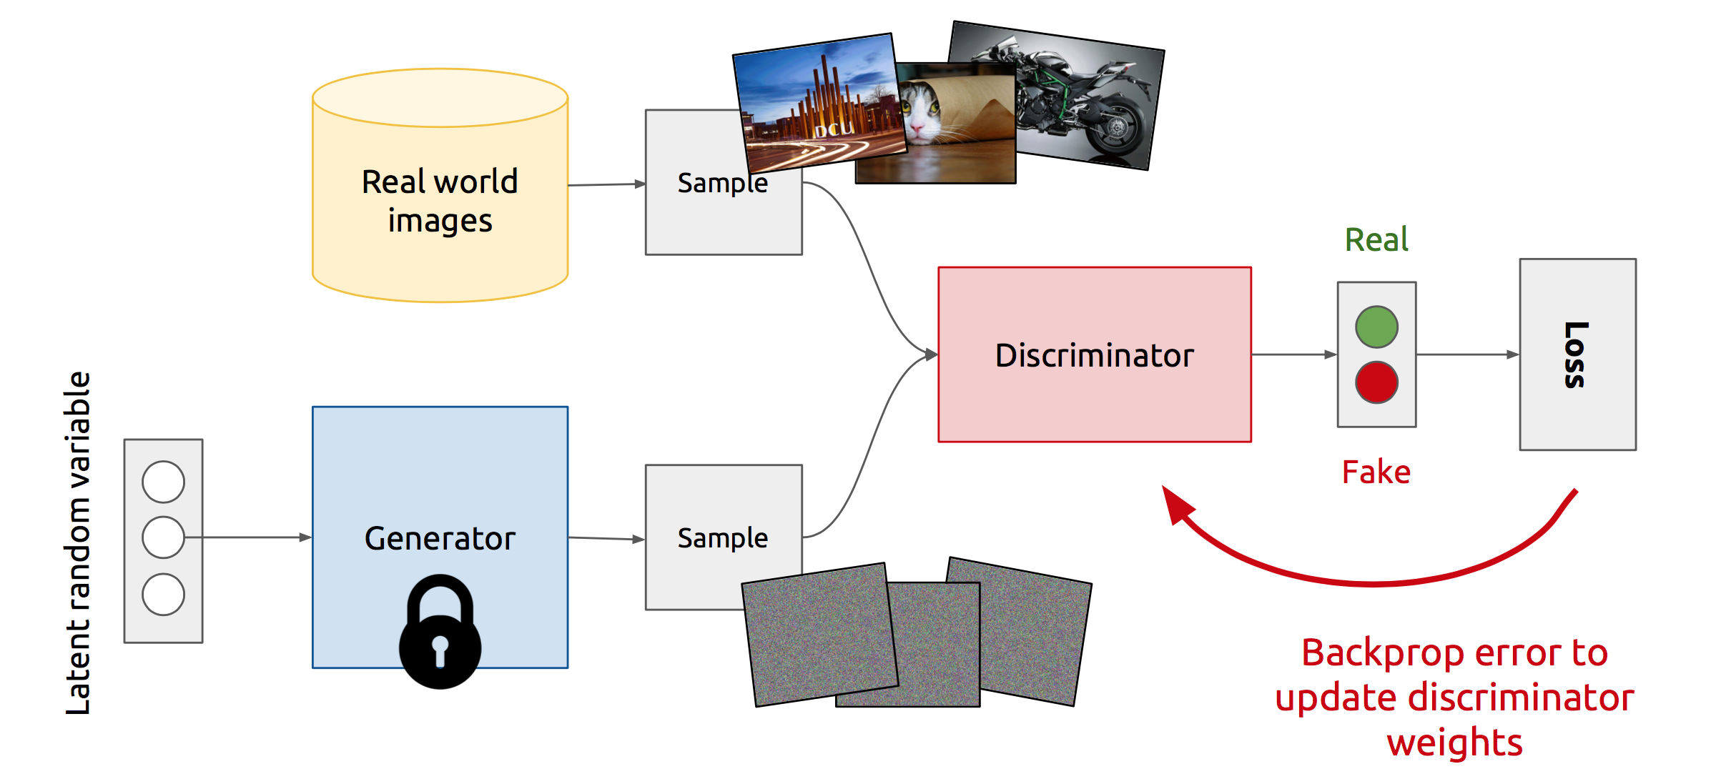
Training Discriminator
Notes:
So, this is how GANs operate :-
At the start of the iteration, a true example is selected and passed through the discriminator. The discriminator outputs the probability of it being a real example, calculate its loss, and update its weights while keeping the generator weights as constant.

Slide 9
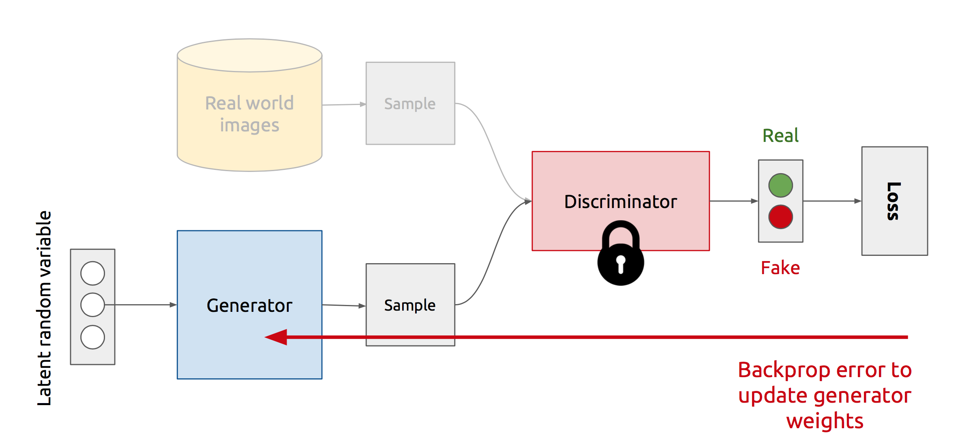
Training Generator
Notes:
Now :-
Generator selects a random noise z, passes it through the generator network to generate a fake image, and then passes it through the discriminator network to output the probability of it being fake. It then calculates its loss, and update its weights while keeping the discriminator’s weights as constant
And we repeat this process of Alternate updates.
Act as complicated loss function.

Slide 10
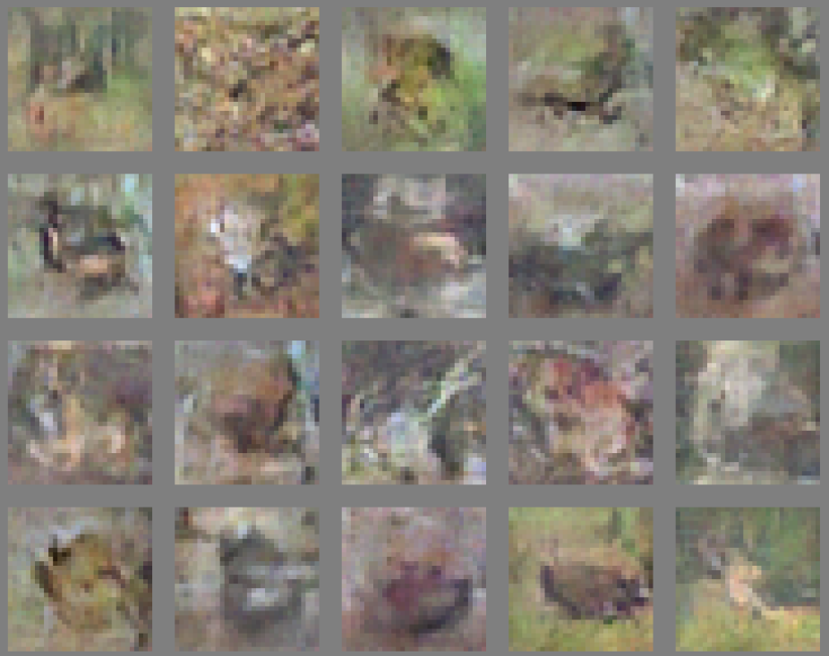
CIFAR
Notes:
However, when trained on CIFAR dataset, the quality of images is not that good..
One can argue that it is easy to generate faces as compared to different classes of objects
So, this wasn’t so inspiring.. Then came the first GAN architecture that did a great job at generating high quality images .. DCGAN

Slide 11
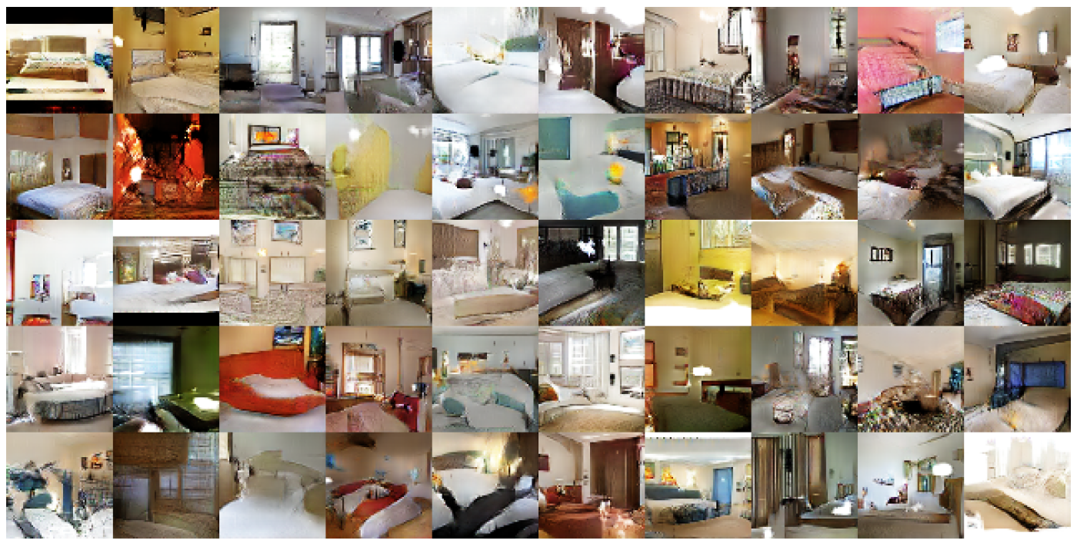
DCGAN: Bedroom images
Notes:
For instance, with DCGAN you can generate such nice looking bedroom images .. Since these are low resolution, zooming it up will pixelate it, so we won’t zoom on a single image

Slide 12
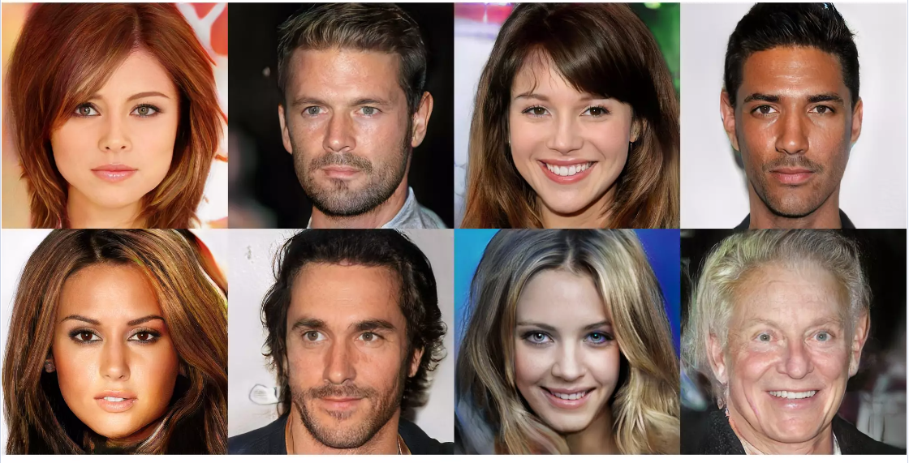

Slide 13
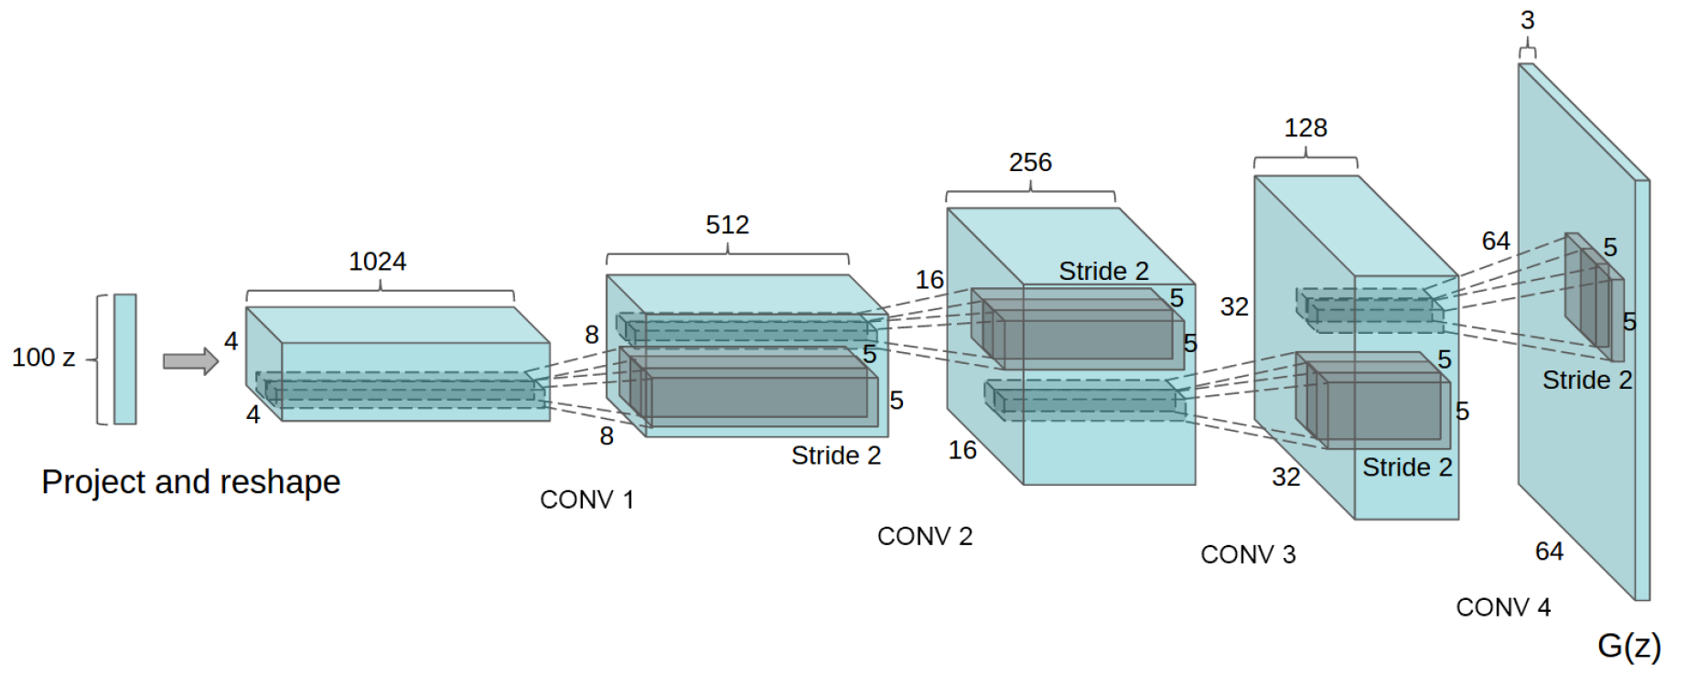
Deep Convolutional GANs (DCGANs)
Key ideas:
Replace FC hidden layers with Convolutions
Use Batch Normalization after each layer
Inside Generator
Use ReLU for hidden layers
Use Tanh for the output layer
Generator Architecture
Notes:
[..]
Reference :- Fractionally-Strided Convolutions: Liwei’s Presentation

Slide 14
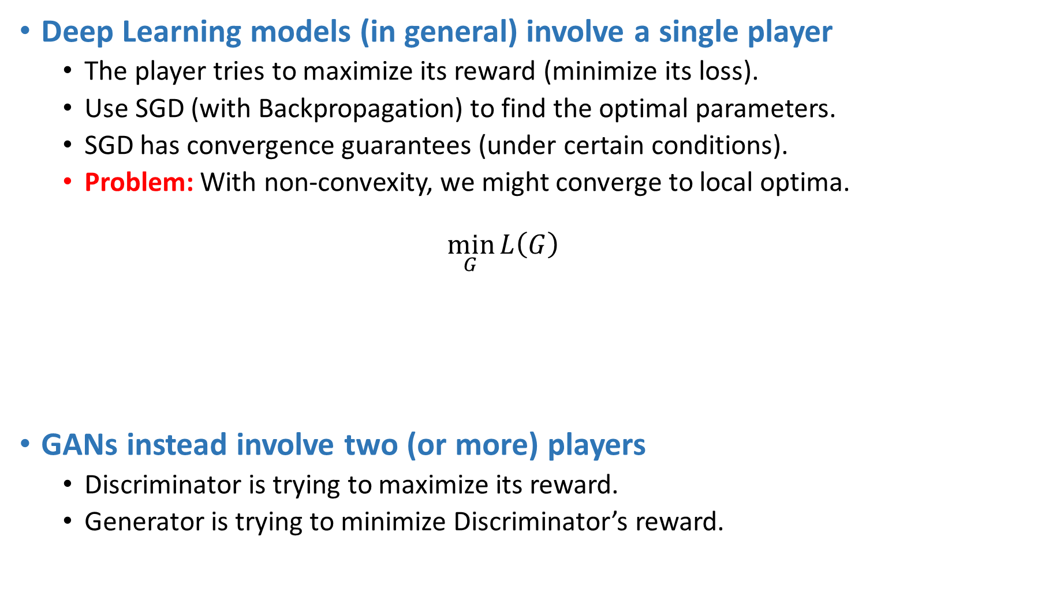
Non-Convergence
Deep Learning models (in general) involve a single player
The player tries to maximize its reward (minimize its loss).
Use SGD (with Backpropagation) to find the optimal parameters.
SGD has convergence guarantees (under certain conditions).
Problem: With non-convexity, we might converge to local optima. $\min_{G}{L\left(G\right)}$
GANs instead involve two (or more) players
Discriminator is trying to maximize its reward.
Generator is trying to minimize Discriminator’s reward.
$$\min_{G}{\max_{D}{V\left(D, G\right)}}$$
Notes:
Having seen an example of Non-Convergence, let’s see why this might be happening…
[..]
--So, what kind of convergences guarantees do we really have?

Slide 15
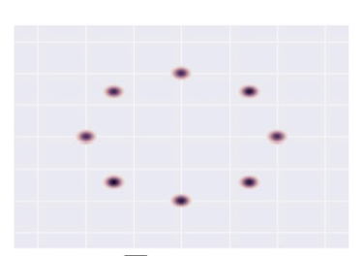
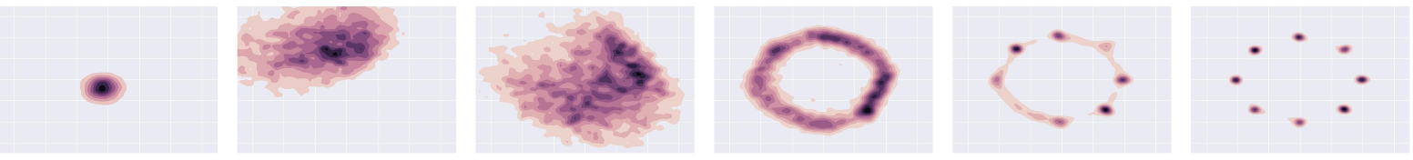
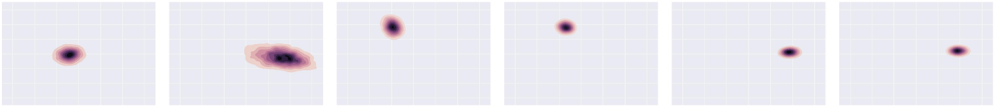
Mode-Collapse
Generator fails to output diverse samples
Target
Expected
Output
Notes:
[..]
-- For instance, given that your real examples are generated from this 2D Gaussian Distribution (with 8 modes), you would expect your generated distribution to follow this trajectory
-- However, in practice, this happens.. i.e. your generated samples move from one mode to another, and fail to capture all the modes .. Thus, you don’t get diversity in the generated samples

Slide 16
Supervision with Labels
Label information of the real data might help
Empirically generates much better samples
Car
Dog
Real
D
D
Human
Fake
Fake
Notes:
A purely heuristic method – there is no understanding as to why this method works…
The idea is very simple i.e. instead of having a binary classification problem of Fake vs Real in the Discriminator .. You replace it with a Multi-class classification problem where K classes are for the K labels in the dataset, and the K+1th class is for the fake image.
And correspondingly modify the cross-entropy loss .. So the new cross entropy loss now will contain K+1 terms.

Slide 17
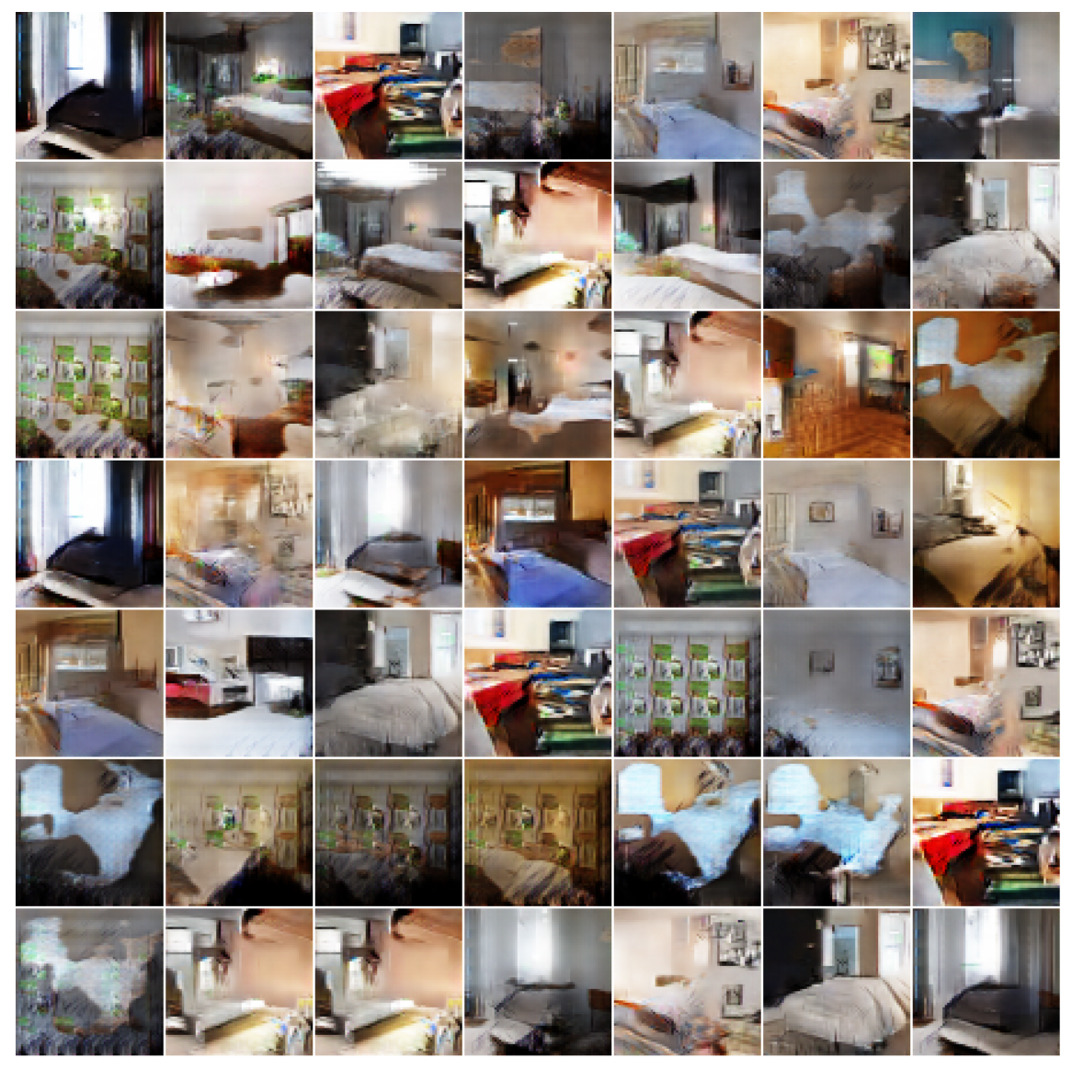
More Bedrooms…
Notes:
Like DC-GAN .. EB-GANs are able to generate good high resolution images

Slide 18
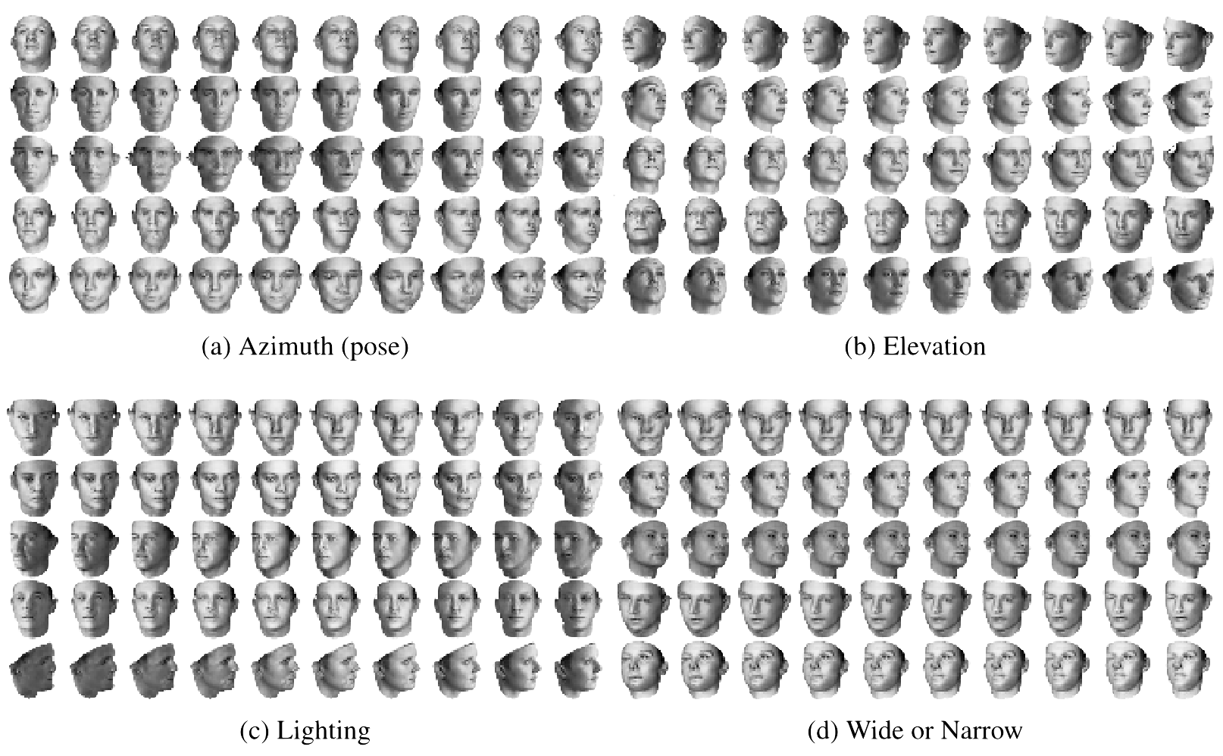
Feature parameterization
3D Faces
Notes:
-- So, training GANs is tricky, but when they do work, they can do some really cool stuff.. I’ll cover one such cool application, and then Bhargav will go over the rest
-- So, until now we just said that, if you want to generate an image from GANs, sample from a noise distribution, and propagate it through the network.. However, we had no control over what we’ll end up generating
-- Won’t it be cool, if by changing just one dimension in the noise vector, we can control some aspect of the image
-- For instance, let’s say with one initialization of the z vector, I get the first image, now if by changing just one dimension of the z vector, I can make my image to change the pose, it would be pretty cool.. So, in that case, that particular dimension will be handling the pose
of the image.
-- Similarly, a second z dimension can cover the Elevation of the image, a third z dimension can cover the Lighting and the fourth, the
width of the image.
-- Note that, you’ll most likely never find so many poses of the same person in your training set, however, your generator has learnt to control these aspects by looking at different poses of different people.
-- So, this is pretty cool… Just imagine how much robust your standard training can become by looking at all these additional examples

Slide 19
Conditional GANs
Applications
Image-to-Image Translation
Text-to-Image Synthesis
Face Aging
Advanced GAN Extensions
Coupled GAN
LAPGAN – Laplacian Pyramid of Adversarial Networks
Adversarially Learned Inference
Summary
Notes:
Quick Recap here.

Slide 20
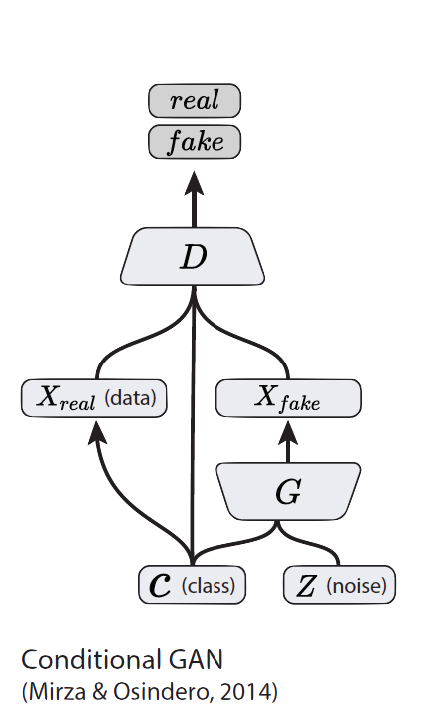
Conditional GANs
Simple modification to the original GAN framework that conditions the model on additional information for better multi-modal learning.
Lends to many practical applications of GANs when we have explicit supervision available.

Slide 21
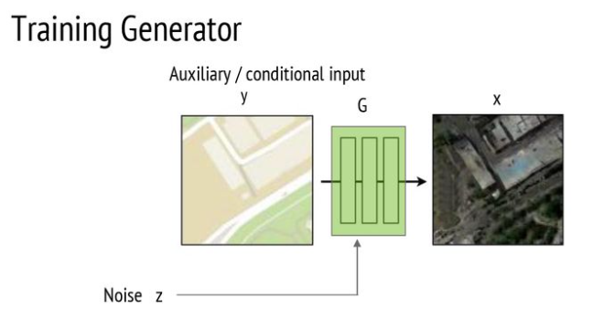

Slide 22
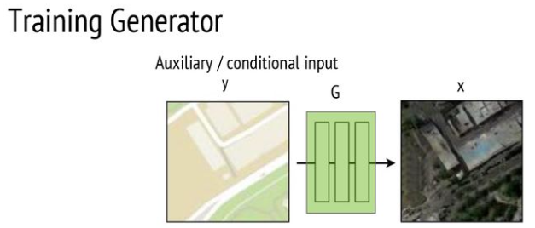

Slide 23
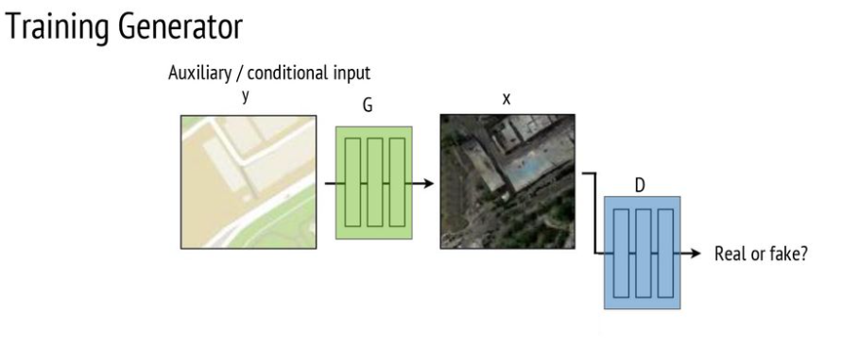

Slide 24
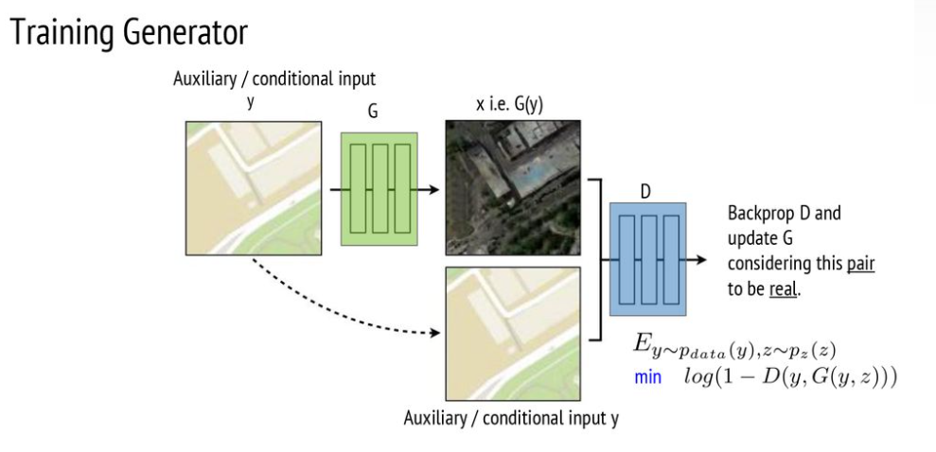

Slide 25
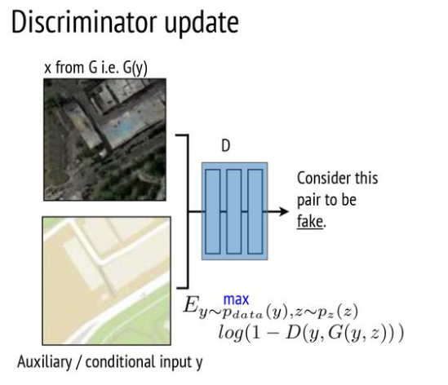

Slide 26
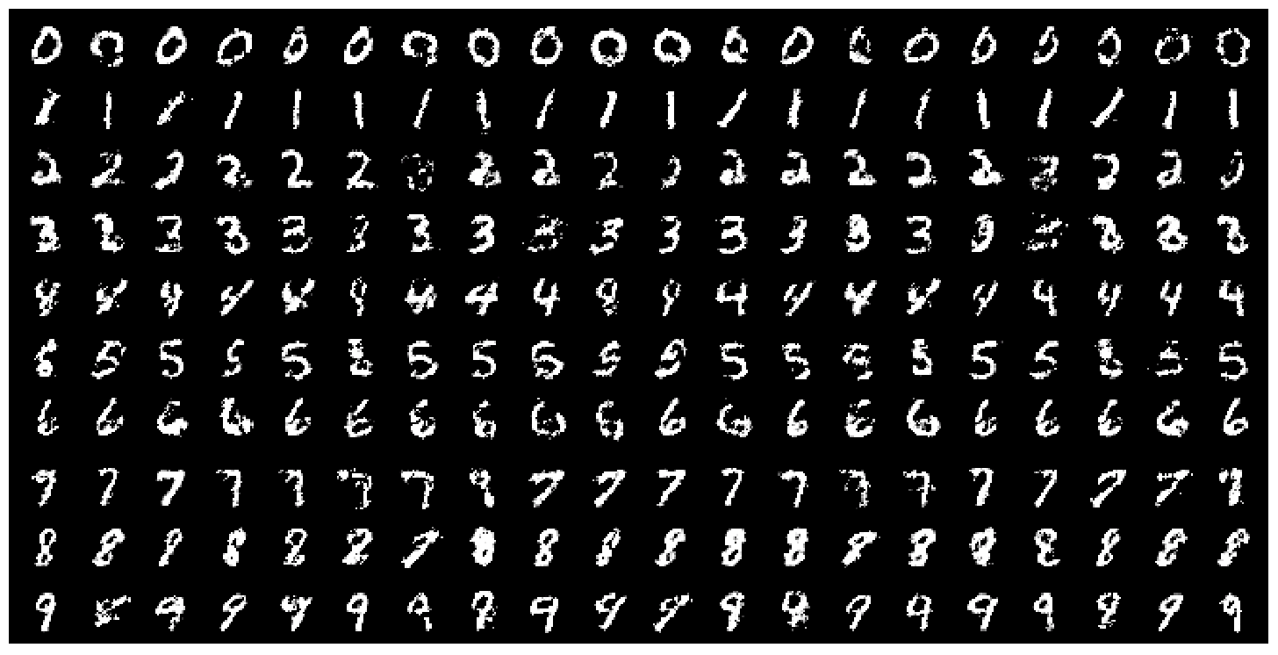
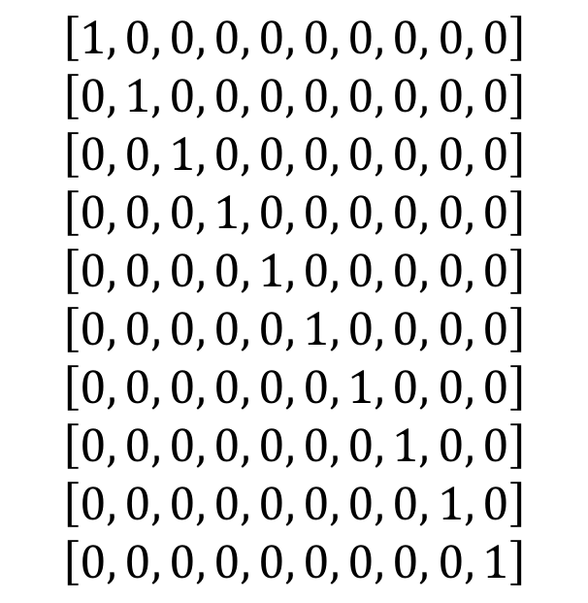
Conditional GANs
MNIST digits
generated conditioned on their class label.
$$\left[1, 0, 0, 0, 0, 0, 0, 0, 0, 0\right]$$
$$\left[0, 1, 0, 0, 0, 0, 0, 0, 0, 0\right]$$
$$\left[0, 0, 1, 0, 0, 0, 0, 0, 0, 0\right]$$
$$\left[0, 0, 0, 1, 0, 0, 0, 0, 0, 0\right]$$
$$\left[0, 0, 0, 0, 1, 0, 0, 0, 0, 0\right]$$
$$\left[0, 0, 0, 0, 0, 1, 0, 0, 0, 0\right]$$
$$\left[0, 0, 0, 0, 0, 0, 1, 0, 0, 0\right]$$
$$\left[0, 0, 0, 0, 0, 0, 0, 1, 0, 0\right]$$
$$\left[0, 0, 0, 0, 0, 0, 0, 0, 1, 0\right]$$
$$\left[0, 0, 0, 0, 0, 0, 0, 0, 0, 1\right]$$
MNIST digits
Notes:
Does not have to be class labels. We can condition on any explicit supervision available.

Slide 27
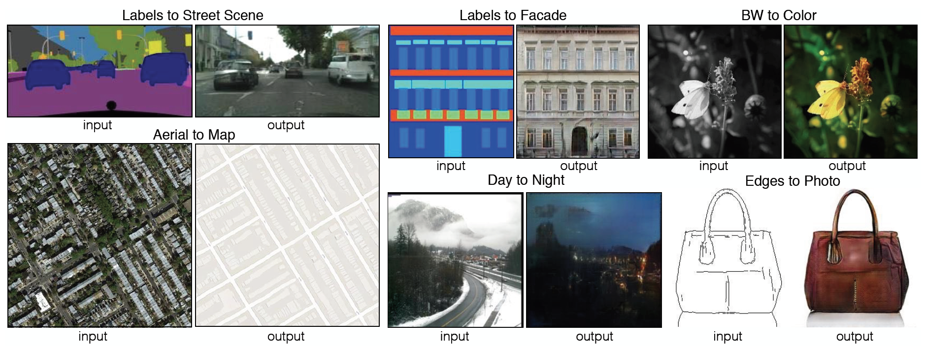
Image-to-Image Translation
Figure 1 in the original paper.

Slide 28
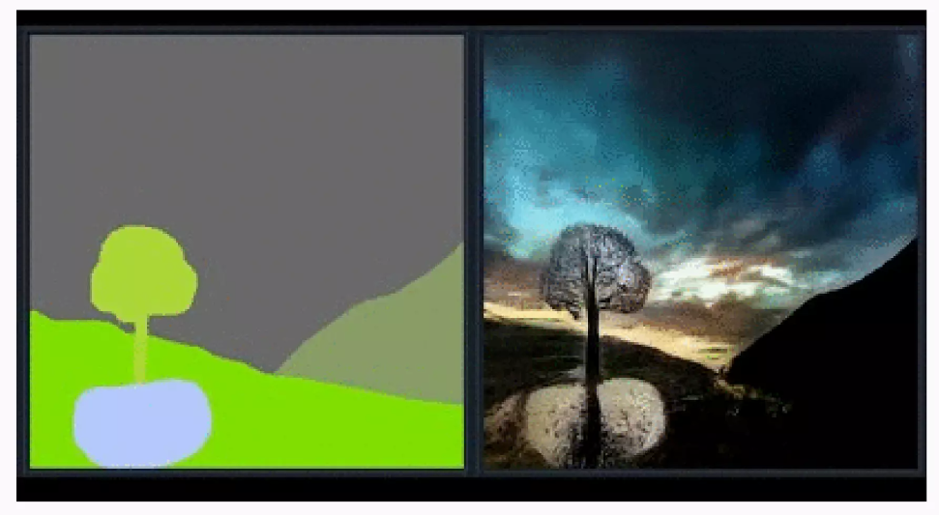
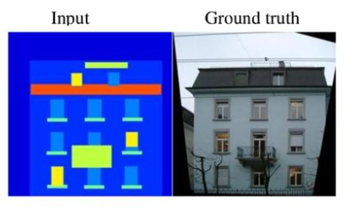
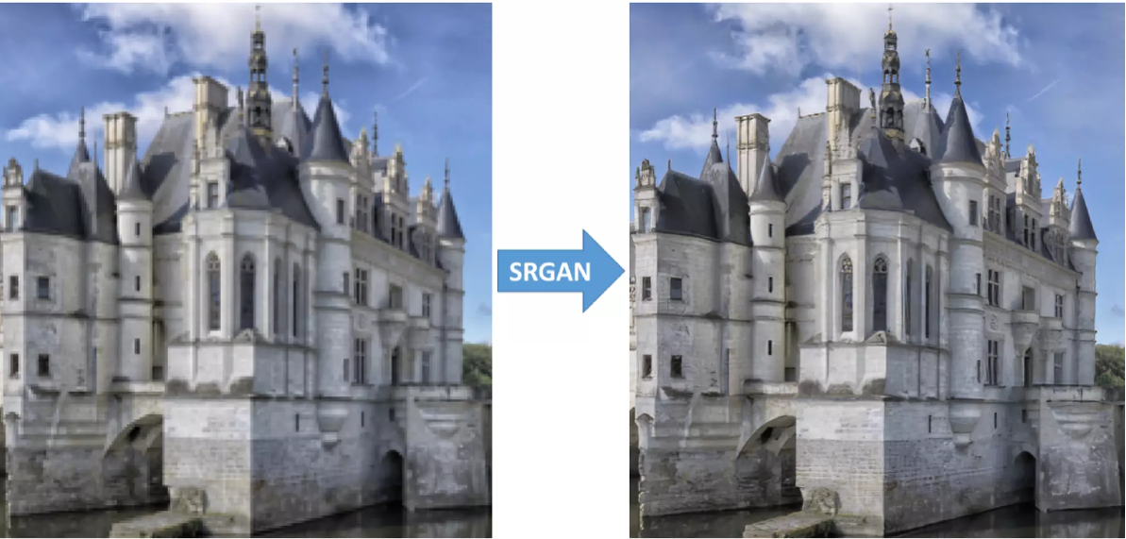

Slide 29
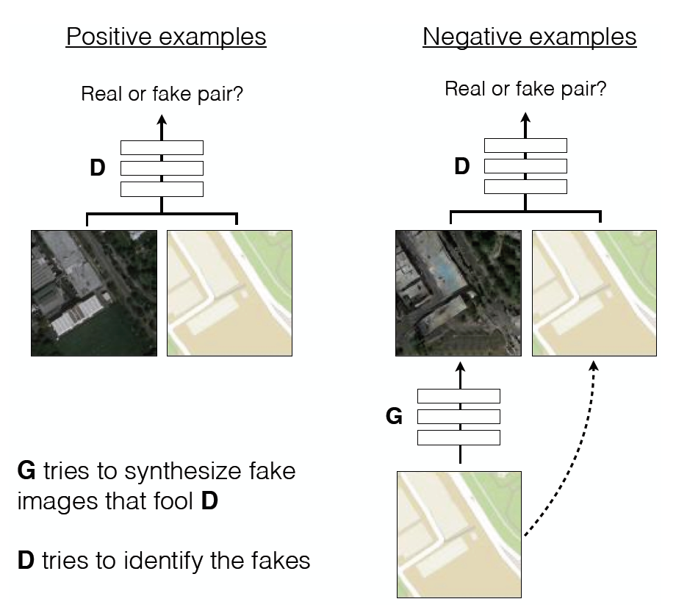
Image-to-Image Translation
Architecture: DCGAN-based architecture
Training is conditioned on the images from the source domain.
Conditional GANs provide an effective way to handle many complex domains without worrying about designing structured loss functions explicitly.
Figure 2 in the original paper.
Notes:
DCGAN shows a set of constraints that work for training GANs and most of the application follow their architecture closely.
No need to design effective loss functions for each domain. GAN gives a “structured loss” for free.

Slide 30
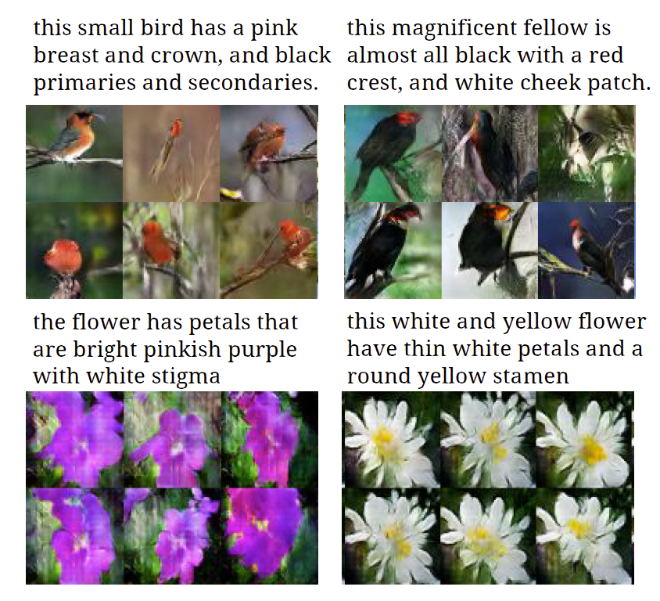
Text-to-Image Synthesis
Motivation
Given a text description, generate images closely associated.
Uses a conditional GAN with the generator and discriminator being conditioned on “dense” text embedding.
Figure 1 in the original paper.
Notes:
Talk about the diversity of images also.

Slide 31
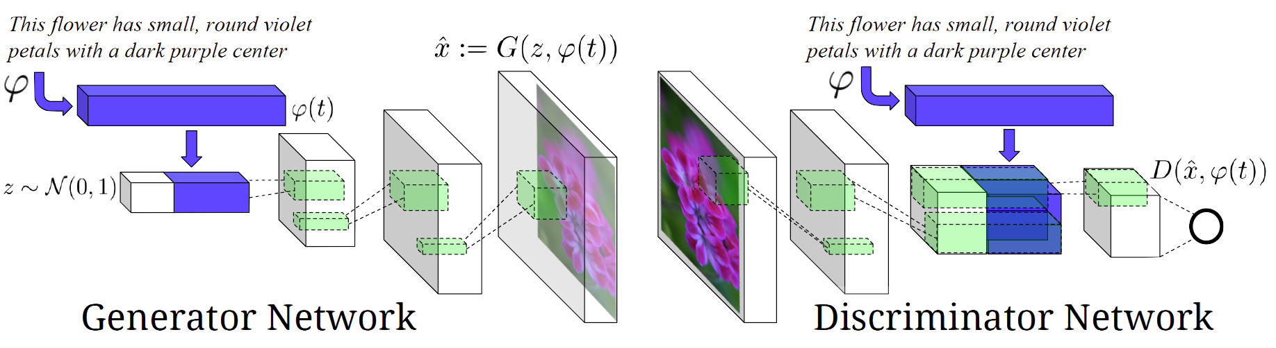
Text-to-Image Synthesis
Figure 2 in the original paper.
Positive Example:
Real Image, Right Text
Negative Examples:
Real Image, Wrong Text
Fake Image, Right Text

Slide 32
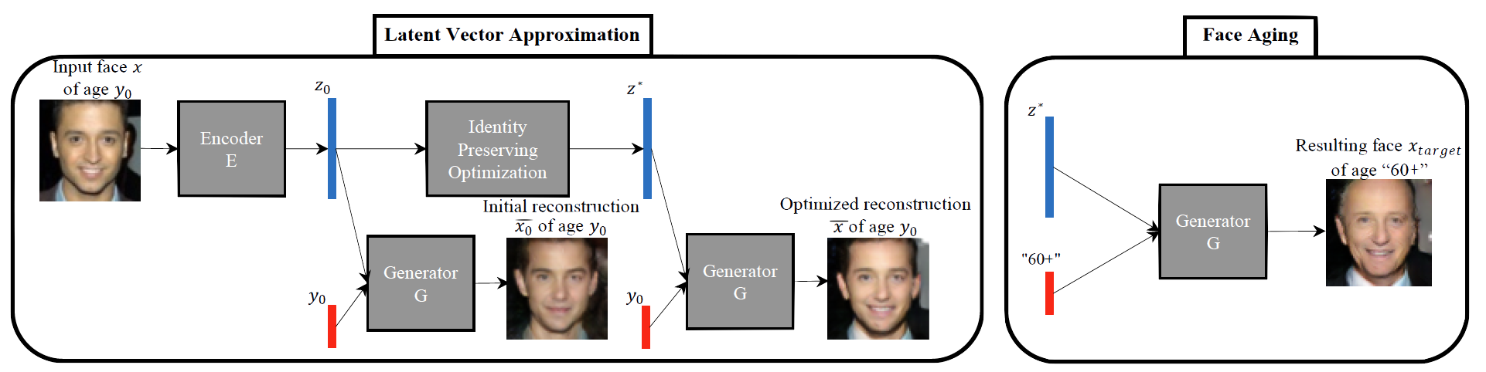
Face Aging with Conditional GANs
Differentiating Feature: Uses an Identity Preservation Optimization using an auxiliary network to get a better approximation of the latent code (z*) for an input image.
Latent code is then conditioned on a discrete (one-hot) embedding of age categories.
Figure 1 in the original paper.

Slide 33
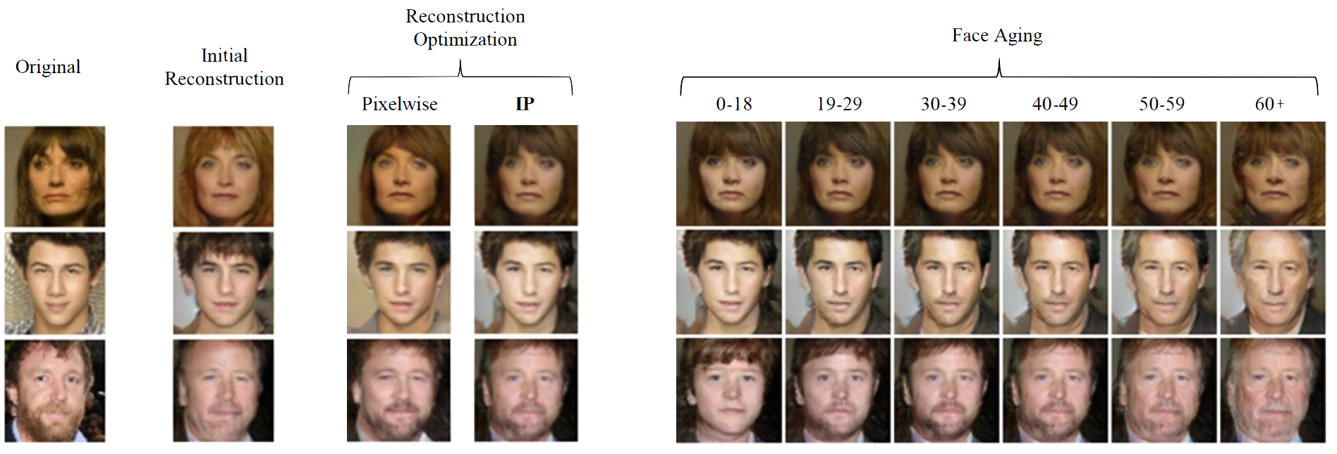
Face Aging with Conditional GANs
Figure 3 in the original paper.

Slide 34
Summary
GANs are generative models that are implemented using two stochastic neural network modules: Generator and Discriminator.
Generator tries to generate samples from random noise as input
Discriminator tries to distinguish the samples from Generator and samples from the real data distribution.
Both networks are trained adversarially (in tandem) to fool the other component. In this process, both models become better at their respective tasks.

